Slide 1
(Greece)
Date: 29th March – 6th April 2021
Sample: 1000
Demographic: Mothers of 0–7-year-olds from Greece

Slide 2
Question:
What do you do when you get some ‘me time’?
Insight
The top things that mums of 0-7-year-olds do when they get some ‘me’ time are:
Watch television (48%)
Go on social media (47%)
Listen to music (45%)
Have a tea/coffee (43%)
Read a book (42%)
(Greece)

Slide 3
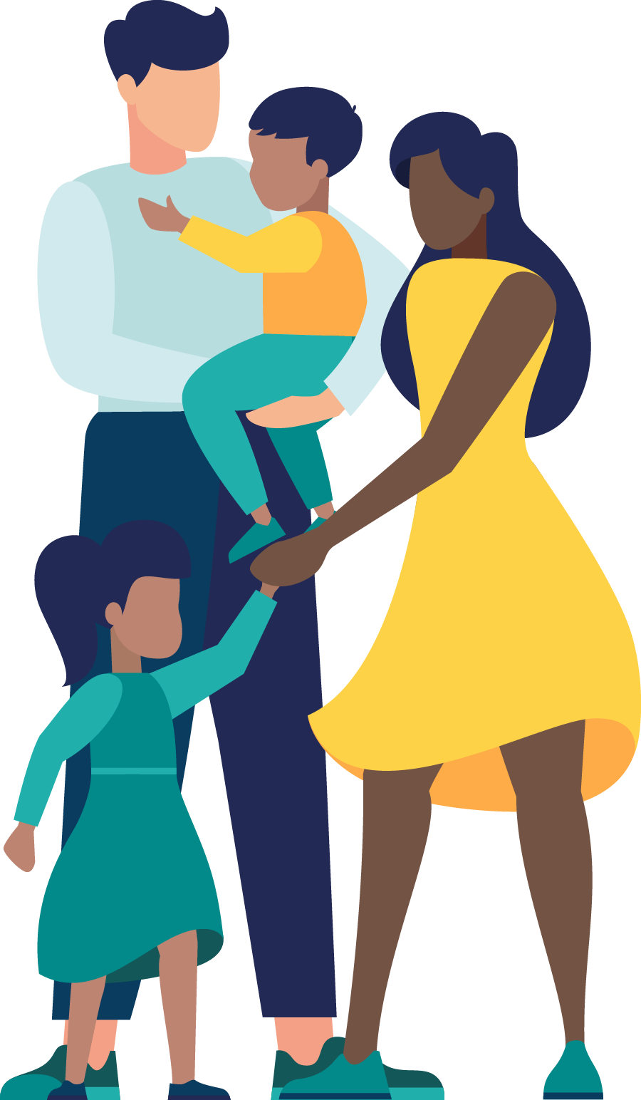
Me-Time
Over four fifths (82%) of mums with 0-7 year olds agree that parenting during the Covid-19 pandemic has left them feeling more exhausted and in need of more ‘me’ time
35% strongly agree that this is the case
5% disagree that parenting during Covid-19 has left them more exhausted/needing more ‘me’ time
On average, mums wish they could have 1 hour and 19 minutes of dedicated ‘me time’ each day
31% want up to 40 minutes
29% want between 41-90 minutes
40% want 91 minutes or more of ‘me time’ each day
Of those that get some dedicated ‘me time’ each day (n=997):
Respondents actually get an average of 51 minutes and 38 seconds of dedicated ‘me time’ per day
47% get up to 40 minutes
37% get between 41-90 minutes
16% get 91 minutes or more of ‘me time’ each day

Slide 4
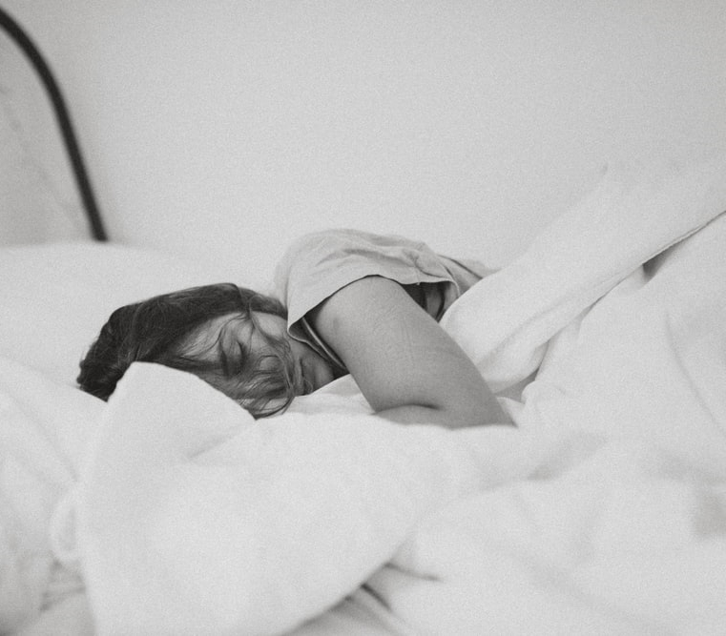
Treats
82% agree that since becoming a mum, they have seen sleep as being a treat rather than something they should expect
40% strongly agree
Just 5% disagree that they have seen sleep as a treat
Almost three quarters (73%) agree that the greatest Mother’s Day gift they could receive this year would be some rest and relaxation
33% strongly agree
7% disagree that this would be the greatest gift
Of those that celebrate Mother’s Day (n=977):
45% consider an extra hour or two in bed resting to be a better Mother’s Day gift this year than chocolate and flowers
35% would consider chocolate and flowers to be the better Mother’s Day gift
14% had no preference between the two options

Slide 5
Question:
What other everyday things do you consider a treat since becoming a parent?
Insight
Since becoming a parent, 55% now consider peace and quiet to be a treat
This was followed by:
Being able to watch the TV shows they want (41%)
Not being interrupted when doing something (40%)
(Greece)

Slide 6
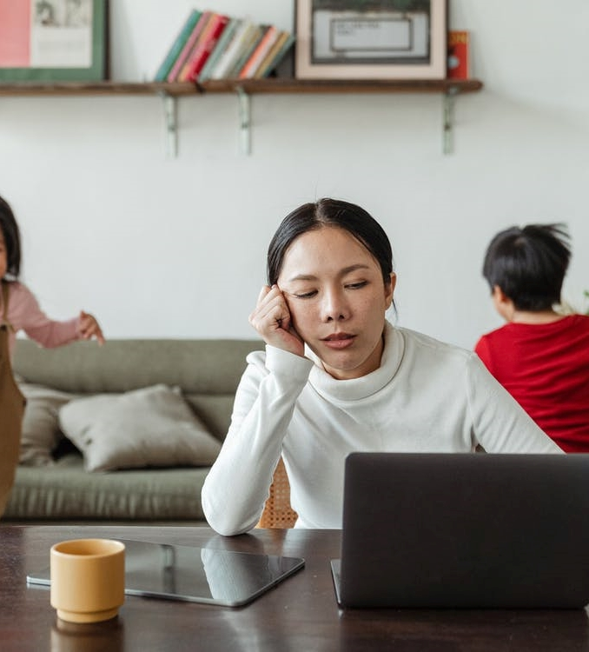
Parental Pressure
80% agree that the Covid-19 pandemic has increased parental pressures for them
38% strongly agree
6% disagree that Covid-19 has increased parental pressures
Of those who agree that Covid-19 has increased their parental pressures (n=799):
42% state they are getting less ‘me’ time each day
28% reported no change to their ‘me’ time
Another 28% are getting more ‘me’ time each day
34% state they are getting less sleep each night
35% reported no change to their sleep
27% are getting more sleep each night
Of those that are getting less sleep each night as a result of increased parental pressures due to Covid-19 (n=274):
On average, they are losing 2 hours and 46 minutes of sleep per night
(Greece)

Slide 7
Question:
If you’ve gotten less sleep each night as a result of increased parental pressures due to the Covid-19 pandemic, why is this?
Insight
Of those that are getting less sleep each night as a result of increased parental pressures due to Covid-19 (n=274):
The top reasons for the reduction in sleep are:
Because they have too much on their mind (55%)
Because they are stressed and can’t sleep (52%)
Because their children aren’t sleeping as well and this affects them (48%)
(Greece)

Slide 8
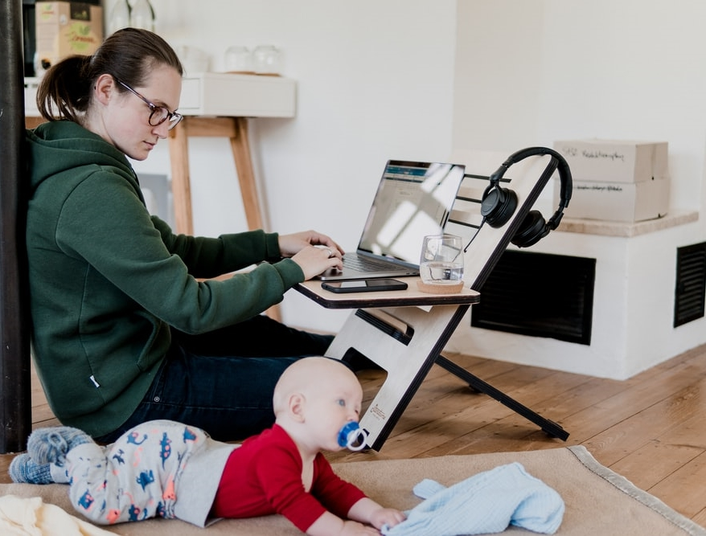
Juggling
47% know how important it is to make time for themselves
42% tend to forget to give themselves some time off
40% are constantly tired
And 39% put too much pressure on themselves to be a good mum
61% have had to juggle both childcare and a job during the Covid-19 pandemic
29% don’t feel they’ve had to juggle childcare and their job
Of those that have had to juggle childcare and a job during the Covid-19 pandemic (n=608):
52% reported feeling more tired as a result of juggling childcare and a job
51% have had to put their needs last to ensure their family/job are prioritised
50% have had less time to themselves than ever
36% have not focused on their own wellbeing as much
And 33% have not performed as well at work
(Greece)

Slide 9
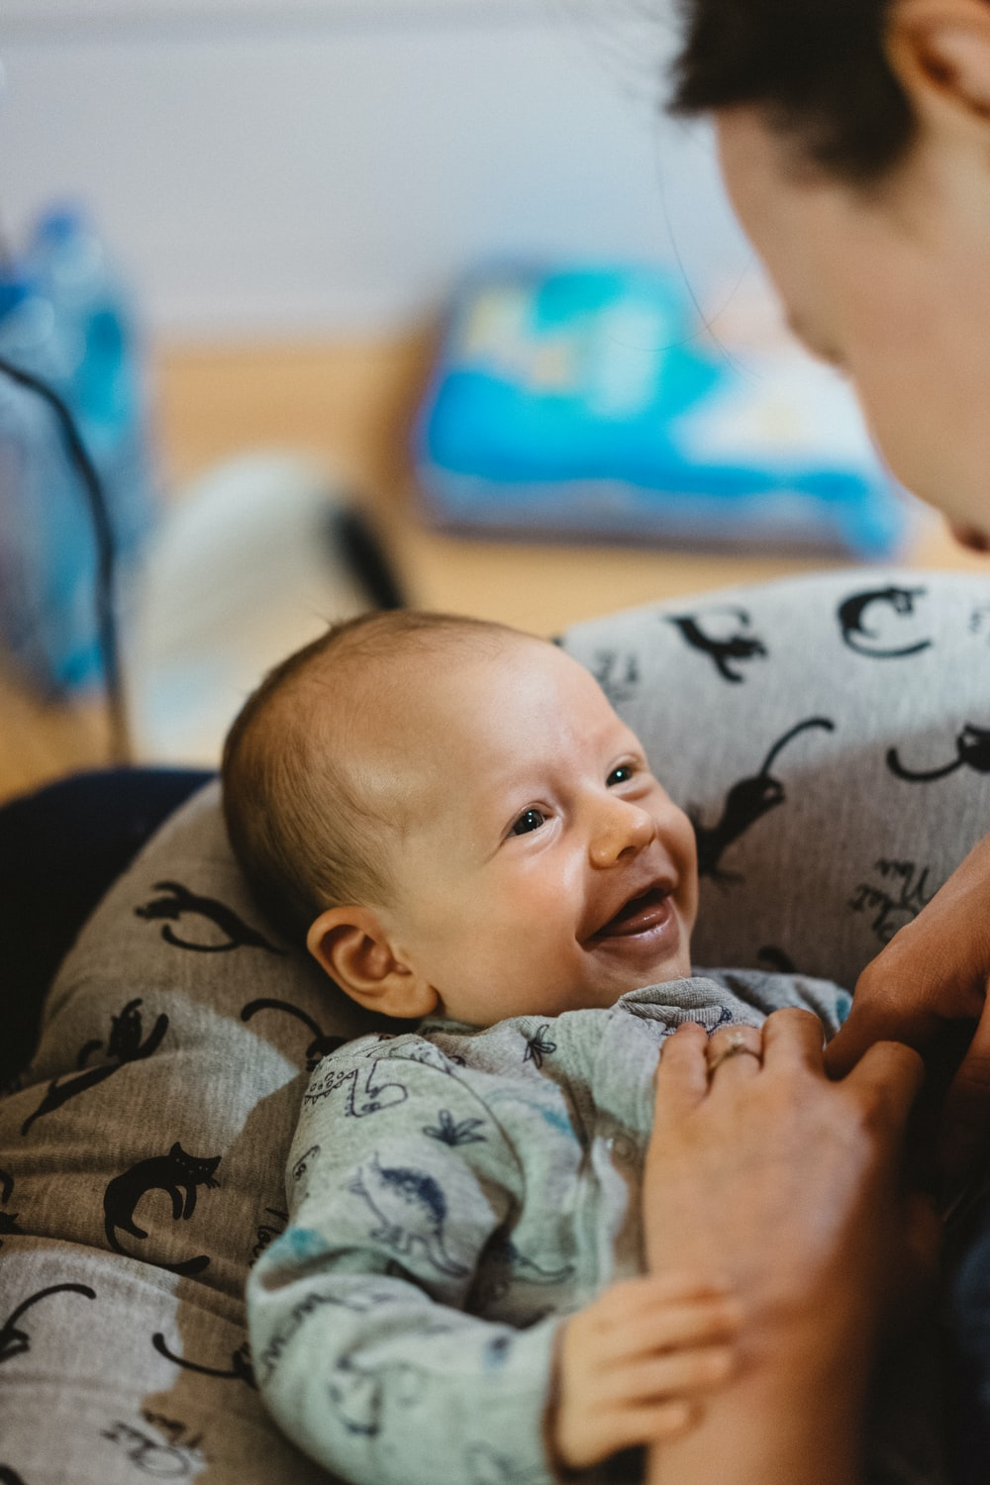
Question:
Which of the following words do you think describe motherhood?
Insight
52% of mums with 0–7-year-olds would describe motherhood as beautiful
This was followed by:
Wonderful (51%)
Rewarding (49%)
Enjoyable (49%)
(Greece)

Slide 10
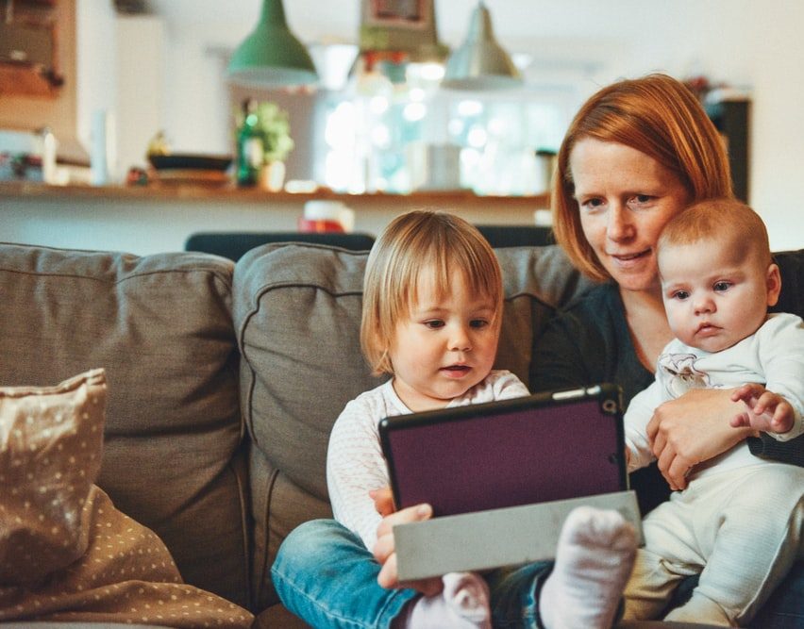
Support
44% dream of a night out with friends when the Covid-19 pandemic is over
37% dream of having a spa day
Another 37% dream of going to the cinema with friends or a partner
41% stated they were unable to shower without being followed/distracted by their child
35% can’t eat without being followed/distracted
33% were unable to go to the toilet without the distraction
Another 33% find they can’t get dressed
And 31% can’t think without the distraction from their child
Two thirds (67%) agree that they perceive Fisher-Price to be a supportive brand for parents of young children during the pandemic
24% strongly agree
Just 3% disagree that Fisher-Price is a supportive brand of parents for parents of young children
(Greece)

