Slide 1
Growing Pains
by
Argyrios Spyridis
http://innovationfarm.eu/

Slide 2
Startup is the new black
http://innovationfarm.eu/

Slide 3
Innovation and technology is now a commodity
“After the end of the startup era”
https://techcrunch.com/2017/10/22/ask-not-for-whom-the-deadpool-tolls/
http://innovationfarm.eu/

Slide 4
Funding is NOT a success story
profits and High Value Exist CAN BE
http://innovationfarm.eu/

Slide 5
Startup idea = great idea – reality
http://innovationfarm.eu/

Slide 6
nobody cares about your idea
http://innovationfarm.eu/

Slide 7
their need > yours
http://innovationfarm.eu/

Slide 8
your solution > available solutions
http://innovationfarm.eu/

Slide 9
Prototype = (it works – nope it doesn’t)+ Presentation
http://innovationfarm.eu/

Slide 10
cost
value
Value Innovation
http://innovationfarm.eu/

Slide 11
30%
8-10%
Of incubators are private
Average equity stake for Incubators & Accelerators
80%
Europe =
1000
USA
=
1250
Startups with HQ in motherland
Incubators & Accelerators
Incubators & Accelerators
http://innovationfarm.eu/

Slide 12
Startups Services
Funding
Services
Beneficiaries
Pre-seed/Seed Capital
Sponsors
Monetary Awards
Loans
Consulting
Product Readiness
Go2 market/Scale up
Investor Readiness
Space
Networking
Early Stage Startups
Scale Ups
Corporations (CSR)
Ecosystem
Business Angels/Funds
http://innovationfarm.eu/

Slide 13
Average Company Life Span
1995 - 2015 = 33 years
2016 - 2020 = 14 years
http://innovationfarm.eu/

Slide 14
MARKET SECTOR | AVERAGE EXIT TIME (YRS)
Health & Wellness | 3,0
Data Storage & Security | 6,0
Customer Relationship Management | 3,0
Travel | 2,0
HR & Workforce Management | 3,0
Application & Data Integration | 2,0
Accounting & Finance | 6,0
Supply Chain & Logistics | 6,0
Food & Grocery | 2,5
http://innovationfarm.eu/

Slide 15
10 Biggest Programs Exits / Funding
Most Successful Programs Exits / Funding
http://innovationfarm.eu/

Slide 16
No team - No go
http://innovationfarm.eu/

Slide 17
avoid startup tourism
&
find your best fit
http://innovationfarm.eu/

Slide 18
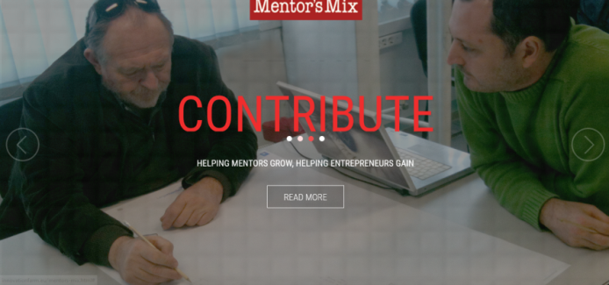
http://innovationfarm.eu/
https://www.facebook.com/InnovationFarm
https://www.instagram.com/innovationfarm
http://innovationfarm.eu/mentors-mix.html
https://www.facebook.com/InnovationFarm
http://stageone.innovationfarm.eu/
https://www.facebook.com/StageOneAccelerator
http://stagetwo.innovationfarm.eu
https://www.facebook.com/stagetwo.accelerated.incubation

